Slide 1


USING
SCAN TOOLS
ON OBD II VEHICLES
(1996 OR NEWER)

Slide 2
SCAN TOOL – WHY LEARN HOW?
FUN TOOL TO USE
YOU DON’T GET DIRTY
AVERAGE SHOP CHARGE $85-$100
AVERAGE TIME TAKEN 15-20 MIN.
THIS EQUALS ABOUT $300 /HOUR (YOU SAVE)
DOESN’T INCLUDE REPAIRING PROBLEM

Slide 3
SCAN TOOL – MATERIALS NEEDED
EYE PROTECTION
FLOOR MATS AND SEAT COVERS
SCAN TOOL
WORK ORDER
YOUR BRAIN
ALL-DATA
VEHICLE

Slide 4
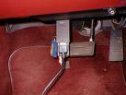
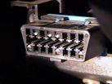
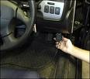
SCAN TOOL – PROCEDURE
STEP 1 – LOCATE DIAGNOSTIC CONNECTOR IN VEHICLE ASSIGNED USING ALL-DATA OR OWNER’S MANUAL

Slide 5
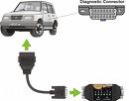

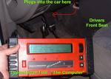




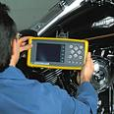
SCAN TOOL – PROCEDURE
STEP 2 – CONNECT SCAN TOOL

Slide 6

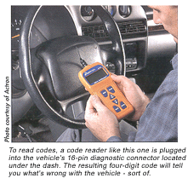
SCAN TOOL – PROCEDURE
STEP 3 –WITH SCAN TOOL CONNECTED, TURN IGNITION ON,
BUT DO NOT START ENGINE!

Slide 7
DO NOT START ENGINE!

Slide 8
SCAN TOOL – PROCEDURE
STEP 4 -
TURN ON SCAN TOOL AND INPUT INFORMATION ABOUT VEHICLE
YOU WANT TO RETRIEVE STORED
DIAGNOSTIC TROUBLE CODES (DTCs)
THIS MIGHT BE UNDER ENGINE SCAN DIAGNOSTICS

Slide 9
SCAN TOOL – PROCEDURE
DOCUMENT DTCs FOUND ON YOUR REPAIR ORDER AND ALSO WHAT THE DTCs INDICATE AS THE SOURCE OF TROUBLE
MAKE SURE TO COMPLETE ALL PARTS OF YOUR WORK ORDER.

Slide 10
CLEAN-UP
NOW PUT AWAY THE SCAN TOOLS
CLEAN UP ALL WORK AREAS IN THE SHOP
HAVE INSTRUCTOR SIGN YOUR
COMPLETED REPAIR ORDER.
TURN IN YOUR WORK

Slide 11
THIS IS
JUST THE BEGINNING!

